Slide 1


TRACK: MESSAGING
APACHE BOOKKEEPER KV STORE AND USE CASES
SHIVJI KUMAR JHA
@ShivjiJha
in/shivjijha

Slide 2

About Me
Senior MTS at Nutanix
Platform Engineer
DBs, SOA, Infra, Streams
Love
Distributed data systems
Open-source software (OSS)
OSS Contributions
Apache Pulsar
MySQL

Slide 3
Contents
Why KV store?
What is bookkeeper?
How to use bookkeeper?

Slide 4
History of Data Stores

Slide 5

A Brief History…
Of Databases
1960: Flat Files
1960s: Hierarchical Databases
1980: SQL / Relational Databases
High-level language
Abstractions: Schema, Transactions, Indexes
2004: NoSQL
Scale & Availability above all
No relational model
2010s: Distributed SQL
Image source: https://commons.wikimedia.org/wiki/File:Human_evolution.svg

Slide 6
A Brief History…
Of Data Streams
Apache Kafka:
Built inside LinkedIn
2011: Kafka becomes open source
2012: Graduated from Apache incubator
Apache Pulsar
Built at Yahoo
2016: Contributed to Open source
2018: Top-level Apache project
Image source: https://commons.wikimedia.org/wiki/File:Human_evolution.svg

Slide 7

A Brief History…
Of Apache Bookkeeper
Born at Yahoo! Research
Evolved from Apache Zookeeper (ZK)
2011: Incubated as subproject under ZK
2015: Top level Apache Project

Slide 8
Apache Bookkeeper
What is Bookkeeper?
Use cases
Infinite Stream of log records
Horizontally scalable storage
Fault-tolerant
Low latency writes
Offers
Durability
Tunable replication
Strong consistency
As write ahead log (WAL) in
HDFS namenode (first use case)
Twitter’s Manhattan : distributed KV
HerdDB : JVM embeddable distributed database
Apache Pulsar : Message & Offset store
Salesforce : Internal database of application storage
Pravega (DellEMC) : Message store
Bytedance : Internal metadata store

Slide 9
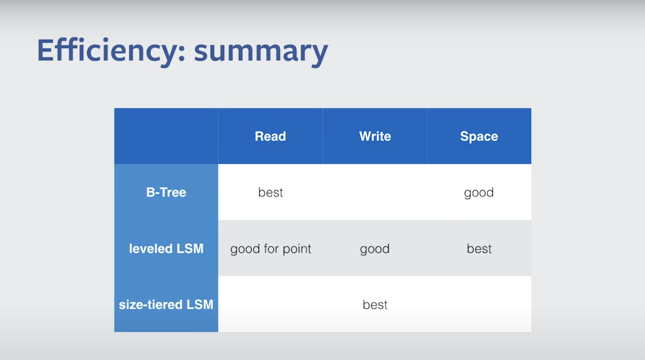
B-tree vs LSM
Primary data structures for storage engines.
B-trees behind traditional databases
MySQL, PostgreSQL
Indexing for expensive random access on HDD
Log structured Merge (LSM) trees
Good write throughput
Behind variety of the modern workloads
Stream : Apache Bookkeeper, Kafka Streams, Apache Pulsar, Flink,
OLTP : MyRocks, MongoRocks, Rocksandra, YugaByte, CockroachDB
TSDB : influxDB
Take advantage of SSD throughput

Slide 10
Key Value stores
KV stores as common core behind:
Key Value databases
Relational databases
Key : Primary Key, Value: Complete row
Document databases
Key : Primary Key (internal?), Value: document
Streaming Platforms
rocksDB based : Apache Pulsar, Kafka Streams, Flink
Good idea to have less clusters!
Good idea to have same base (KV) across clusters!

Slide 11
Bookkeeper = ZK + rocksDB
RocksDB
Zookeeper
Implements LSM
Embeddable
Key Value store
Append only
Low latency
High throughput
Duplicate record for update / delete
Compaction to remove stale / deleted records
Metadata store
Cluster coordination
Service discovery
Leader election
Dynamic configurations
Feature flags

Slide 12
Data Store categories

Slide 13
Plethora of Workloads / Options
OLTP
STREAM QUEUE
TIME
SERIES
OLAP
Cockroach
Yugabyte
(rocks)
Flink, rockset
Herddb (BK)
INFLUX
Pulsar

Slide 14
Database Layers
TRANSPORT
CLIENT
COMMUNICATION
CLUSTER
COMMUNICATION

Slide 15
Database Layers
TRANSPORT
CLIENT
COMMUNICATION
CLUSTER
COMMUNICATION
QUERY PROCESSING
QUERY PARSER
QUERY OPTIMIZER

Slide 16
Database Layers
TRANSPORT
CLIENT
COMMUNICATION
CLUSTER
COMMUNICATION
QUERY PROCESSING
QUERY PARSER
QUERY OPTIMIZER
EXECUTION
ENGINE
REMOTE EXECUTION
LOCAL EXECUTION

Slide 17
Database Layers
TRANSPORT
CLIENT
COMMUNICATION
CLUSTER
COMMUNICATION
zookeeper
QUERY PROCESSING
QUERY PARSER
QUERY OPTIMIZER
stargate
EXECUTION
ENGINE
REMOTE EXECUTION
LOCAL EXECUTION
Choice with bookkeeper (thick client, ensemble, WQ, RQ)
TRANSACTION MANAGER
LOCK MANAGER
Zookeeper (LM), Journal (RM), Bookie (SM), TM = ?
STORAGE ENGINE
STORAGE MANAGER
RECOVERY MANAGER

Slide 18
Bookkeeper Internals

Slide 19
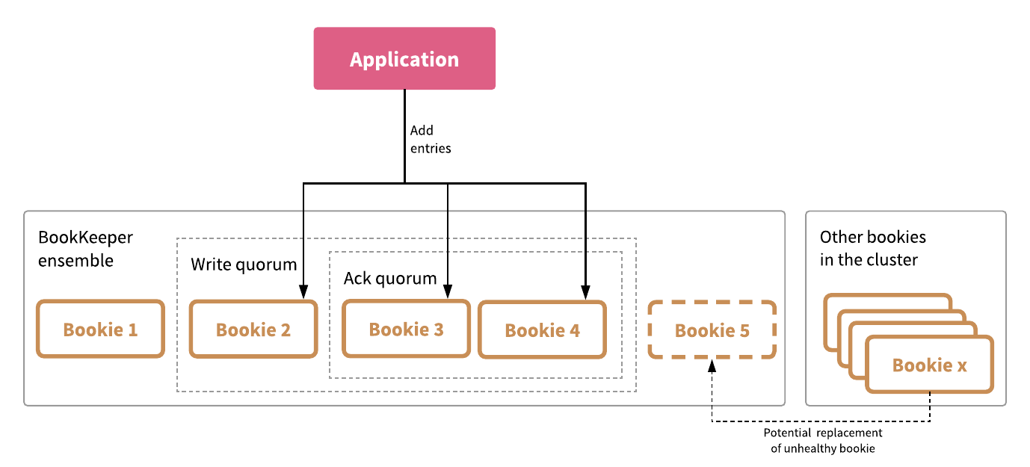
Bookkeeper Cluster : Replication
https://medium.com/streamnative/why-apache-bookkeeper-part-1-consistency-durability-availability-ac697a3cf7a1

Slide 20
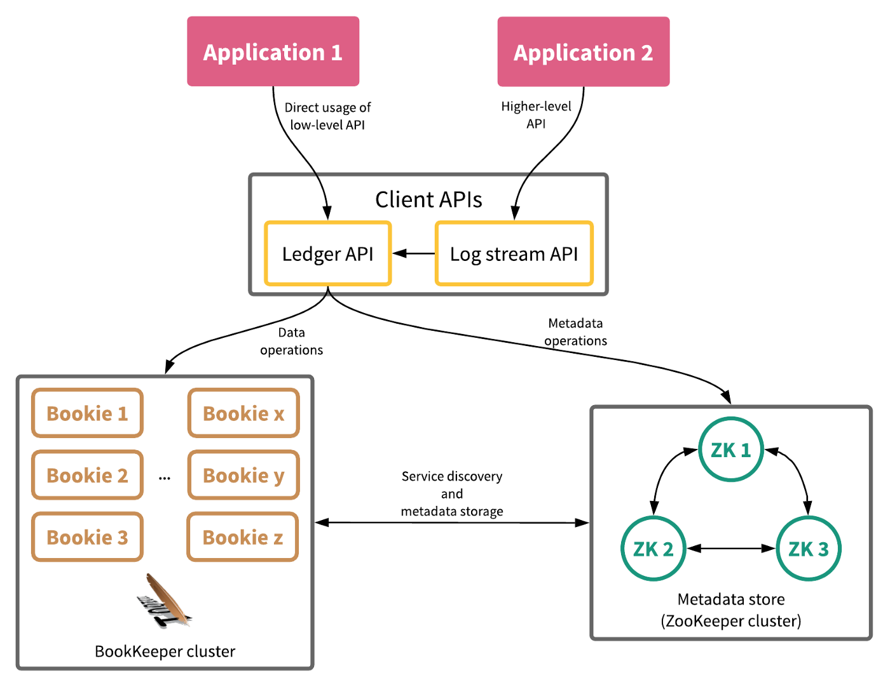
Bookkeeper : Typical Usage
https://medium.com/streamnative/why-apache-bookkeeper-part-1-consistency-durability-availability-ac697a3cf7a1

Slide 21
Bookkeeper Glossary
Entries
Actual data (bytes) written to ledgers.
Plus, metadata
Entry Log File
Actual physical file with entries
Offsets indexed for fast lookup.
Asynchronous garbage collection of deleted and stale entries.
Entry: [ledgerId, entryId, Checksum…]

Slide 22
Bookkeeper Glossary
Journal
Transaction logs (Write ahead log)
Append only semantics
Low latency, high throughput writes
Turn on / off (durability vs throughput)
Ledger
Logical unit of storage for APIs in bookkeeper.
Append-only semantics
Indexed & cached for faster lookups
Includes:[Status, lastEntryId, [entries] replication factors…]

Slide 23
Bookkeeper : Client & Server
Client Based Replication
Bookkeeper has no leader / follower.
Same responsibility across nodes.
Thick bookie client implements replication, coordination, consistency.
Separate Auto detection and restore module if entries lost.
Bookkeeper APIs
Create ledger (sync / async)
Append entry to ledger
Read entry from ledger
Delete Ledger (sync / async)

Slide 24

Bookkeeper Server : Write Path
Bookkeeper Client
Bookkeeper Server
Journal (WAL)
BOOKKEEPER CLIENT

Slide 25
Bookkeeper Server : Write Path
Bookkeeper Client
Bookkeeper Server
Journal (WAL)
Writes
LEDGER APIs
BOOKKEEPER CLIENT

Slide 26

Bookkeeper Server : Append only
Bookkeeper Client
Bookkeeper Server
Journal (WAL)
Writes
LEDGER APIs
BOOKKEEPER CLIENT

Slide 27


Bookkeeper Server : Write Path
Bookkeeper Client
Bookkeeper Server
Journal (WAL)
Write Cache
Writes
LEDGER APIs
BOOKKEEPER CLIENT

Slide 28
Bookkeeper Server : Read-Write
Bookkeeper Client
Bookkeeper Server
Journal (WAL)
Write Cache
Writes
LEDGER APIs
BOOKKEEPER CLIENT
LEDGER APIs
Entry
Log
Files
Reads
Read Cache

Slide 29

Bookkeeper Server : IO isolation
Bookkeeper Client
Bookkeeper Server
Journal (WAL)
Write Cache
Writes
disk
LEDGER APIs
BOOKKEEPER CLIENT
LEDGER APIs
Entry
Log
Files
Reads
disk
Read Cache

Slide 30





Bookkeeper Server : Read Path
Bookkeeper Client
Bookkeeper Server
Journal (WAL)
Write Cache
BOOKKEEPER CLIENT
LEDGER APIs
Entry
Log
Files
Reads
index
Read Cache

Slide 31
Bookkeeper Server : Flush
Bookkeeper Client
Bookkeeper Server
Journal (WAL)
Write Cache
BOOKKEEPER CLIENT
LEDGER APIs
Entry
Log
Files
Reads
Read Cache
Asynchronous, batched flush!

Slide 32
Bookkeeper : Offsets
Last add confirmed (LAC)
Sent in response to write()
Cumulative ack
Readers can read until LAC
Last add pushed (LAP)
Last entry client requested to write.
Write in progress, not acked yet.
READERS
WRITER
Entries
LAC
LAP

Slide 33
Bookkeeper : Recovery
READERS
WRITER
Entries
LAC
LAP

Slide 34
Bookkeeper : Recovery
Bookkeeper Failure
Writer crashed / network partition
Client retries / fails
Retry reaches new bookkeeper node
New Bookkeeper owner
Put Ledger state in recovery
Fences old file with consensus.
Write to new file
New owner back ? Split brain?
NEW
WRITER
READERS
WRITER
Entries
LAC
LAP

Slide 35
Bookkeeper: A Pulsar Use case

Slide 36

Apache Pulsar 101
Apache Pulsar
Cloud-native,
Highlights
Modular Design
Distributed messaging and
Distributed streaming platform
Horizontally scalable
Low latency & high throughput
Multi-tenancy
Geo Replication
PRODUCER
CONSUMER

Slide 37

Apache Pulsar 101
PRODUCER
CONSUMER
BROKER
BOOKKEEPER
ZOOKEEPER

Slide 38
Bookkeeper Server : Read-Write
Bookkeeper Client
Bookkeeper Server
Journal (WAL)
Write Cache
Writes
LEDGER APIs
BOOKKEEPER CLIENT
LEDGER APIs
Entry
Log
Files
Reads
Read Cache

Slide 39
Pulsar Broker & Bookkeeper
Pulsar Broker
Bookkeeper Server
BROKER
Journal (WAL)
Write Cache
Writes
LEDGER APIs
BOOKKEEPER CLIENT
LEDGER APIs
Entry
Log
Files
Reads
Read Cache

Slide 40
Pulsar Broker & Bookkeeper
Pulsar Broker
Bookkeeper Server
BROKER
Journal (WAL)
Write Cache
Writes
LEDGER APIs
BOOKKEEPER CLIENT
LEDGER APIs
Entry
Log
Files
TOPIC1
TOPIC2
TOPIC3
Reads
Read Cache

Slide 41
Pulsar Broker & Bookkeeper
Pulsar Broker
Bookkeeper Server
BROKER
Journal (WAL)
Write Cache
Writes
LEDGER APIs
BOOKKEEPER CLIENT
LEDGER APIs
Entry
Log
Files
TOPIC1
TOPIC2
TOPIC3
Reads
Read Cache
PRODUCER
CONSUMER

Slide 42
Pulsar Broker & Bookkeeper
Pulsar Broker
Topic Ledger Mapping
BROKER
TOPIC 3
BOOKKEEPER CLIENT
MANAGED LEDGER
TOPIC1
TOPIC2
TOPIC3
PRODUCER
CONSUMER

Slide 43

Pulsar Broker & Bookkeeper
Pulsar Broker
Topic Ledger Mapping
BROKER
TOPIC 3
Ledgers[]
schemaLedgers[]
compactedLedgers[]
BOOKKEEPER CLIENT
MANAGED LEDGER
TOPIC1
TOPIC2
TOPIC3
PRODUCER
CONSUMER

Slide 44
Pulsar Broker & Bookkeeper
Pulsar Broker
Topic Ledger Mapping
BROKER
TOPIC 3
Ledgers[]
schemaLedgers[]
compactedLedgers[]
BOOKKEEPER CLIENT
MANAGED LEDGER
ledgerId,
entriesRange,
Ledger size, metadata
TOPIC1
TOPIC2
TOPIC3
PRODUCER
CONSUMER

Slide 45
Pulsar Broker & Bookkeeper
Pulsar Broker
Topic Ledger Mapping
BROKER
TOPIC 3
Ledgers[]
schemaLedgers[]
compactedLedgers[]
BOOKKEEPER CLIENT
MANAGED LEDGER
ledgerId,
entriesRange,
Ledger size, offloaded?
CURSOR 1
CURSOR 2
TOPIC1
TOPIC2
TOPIC3
PRODUCER
CONSUMER
CONSUMER 1
CONSUMER 1

Slide 46
Cluster Coordination: Zookeeper
Pointers to data
Topic ledgers mapping
Ledger topics mapping
Topic schema mapping
Service Discovery
List of available bookies
List of available brokers
Which broker owns which topic
How much load on which topic etc
Distributed coordination
Locks
Leader election
System Configuration
Dynamic configs for hot reload
Feature flags
Provisioning Configuration
Metadata for tenants, namespaces
Namespace policies

Slide 47
Summary
Plethora of databases, workloads, use cases.
Too many clusters – difficult to operate
RocksDB : very popular LSM implementation
High write throughput, leverages SSD throughput
Varied workloads on rocksDB : databases, queues, streams
Bookkeeper : Consistent distributed KV base
Infinite commit log
Can use in a lot of different ways
Apache Pulsar is one example, but a lot more building up!
Fault tolerant, horizontally scalable store behind Pulsar

Slide 48
References
Mark Callaghan - Choosing between Efficiency and Performance with RocksDB
FoundationDB Record Layer – White paper
Why Apache Bookkeeper part 1 : consistency,durability,availability By Sijie Guo
Understanding How Apache Pulsar works By Jack Vanlightly
How Pulsar stores your data – Pulsar Summit NA 2021 By Shivji Kumar Jha
Convergence of Messaging, streaming and storage By Sijie Guo

Slide 49


THANK YOU
QUESTIONS?
@ShivjiJha
in/shivjijha/
shiv4289
ShivjiKumarJha

